Slide 1


HUMAN RESPONSE IDENTIFIER
“Spotting Real vs AI”

Slide 2
Group Members(B-10)
1.Saurabh Kuche(RBT22CS128).
2.Mayuresh Chaudhari(RBT22CS120).
3.Abhishek Paraskar(RBT22CS084).
4.Sahil Patil(RBT22CS136).

Slide 3
Introduction
Online, it seems talking with both humans and machines. But what if we could easily tell the difference? That's where the Human Response Identifier comes in. It helps us know if the information is from a real person or created by AI.
02
03
04
05
06
07

Slide 4

Motivationtion
"Why use Human Response Identifier?"
Online,sometimes it seems talking to a friend, but it might be a machine! Imagine spotting fake news or misinformation easily. Our Human Response Identifier is your digital truth detector. It fights lies.
For instance, if a news story seems fishy, the tool could reveal if it's written by a person or generated by AI. It's about honesty, trust, and keeping our digital world reliable.

Slide 5

Problem Statement
The problem we're addressing is that advanced AI models, like GPT-3, are great at generating human-like text but can make mistakes. This becomes a serious issue when it comes to misinformation, fraud, and the creation of realistic fake videos called deepfakes. We've noticed a specific problem called "Reference Hallucination" in AI writing assistants like ChatGPT. Our goal is to understand and improve the accuracy of these AI models to prevent false beliefs and misinformation.

Slide 6


Literature Survey
1. Evolution of AI-Generated Content
-->1.1 Visual Art and Music (1950s)
- AI's journey in content generation, notably in visual art and music since the 1950s.
- Advancements in AI techniques, such as generative adversarial networks (GANs), leading to highly realistic content.
- Emergence of concerns about misuse, particularly in the creation of deepfakes.
--> 1.2 Technical, Cognitive, and Social Aspects
- Research exploring technical, cognitive, and social aspects of AI-generated content.
- Discussion on errors in AI-generated papers, exemplified by SCIgen, and challenges for large language models in NLP.
- Introduction of Galactica by MetaAI, which organizes scientific knowledge but may assert falsehoods.
- Examination of GPT-3's ability to generate fluent yet potentially undesirable content.
-->1.3 Strategies for Alignment
- Exploration of strategies like reinforcement learning to align AI models with user intent.
- Acknowledgment of ChatGPT's excellence in generating helpful and trustworthy content in conversations.

Slide 7
2. Recognizing and Detecting AI-Generated Text
2.1 Human Behavior for Recognition of AI-Generated Text
Studies by Clark et al. (2021), Zellers et al. (2019), Köbis and Mossink (2021), Kreps et al. (2022), and Jakesch et al. (2022) examining non-experts' responses to AI-generated text.
Findings indicating the difficulty in distinguishing between AI-generated and human-authored content across various contexts.
Consensus on the challenge faced by both experts and non-experts in discerning AI-generated text.
2.2 Detection Models for AI-Generated Text Identification
Introduction of detection models like Grover, developed by Zellers et al. (2019), for generating and detecting fake news.
OpenAI's response with a high-performing GPT-2-generated text detector, fine-tuned using Roberta.
Presentation of Scarecrow by Dou et al. (2022), a framework for detecting machine-generated text errors in news articles.
Mitchell et al.'s (2023) hypothesis on the occurrence of LLM-generated text in areas with negative curvature, leading to the development of DetectGPT.

Slide 8





3. Impact of AI on Scientific Content Generation
3.1 Concerns about Plagiarism
Exploration of concerns about plagiarism arising from the misuse of AI for generating manuscript ideas.
Updates in submission policies by conferences like ICML and ACL to curb fake, plagiarized, or fraudulent content from large-scale language models.
3.2 Tools and Detection Methods
Discussion on tools like SCIgen (since 2005) and efforts by Labbé & Labbé (2013) to detect fake papers.
Estimation of the prevalence of SCIgen papers by Cabanac and Labbé (2021) using word frequency for plagiarism detection.
Advances in models like GPT-3 enhancing text fluency but posing risks of plagiarism.
Introduction of the DAGPap22 shared task aiming to automatically detect generated scientific papers.
3.3 Risks and Shared Task
The impact of AI, particularly writing assistants like ChatGPT, on the creation of self-generated scientific papers.
Risks associated with plagiarism and the harm of mislabeling manuscripts as AI-generated, emphasized by the DAGPap22 shared task reframed by Rosati (2022).
3. Impact of AI on Scientific Content Generation
3.1 Concerns about Plagiarism
Exploration of concerns about plagiarism arising from the misuse of AI for generating manuscript ideas.
Updates in submission policies by conferences like ICML and ACL to curb fake, plagiarized, or fraudulent content from large-scale language models.
3.2 Tools and Detection Methods
Discussion on tools like SCIgen (since 2005) and efforts by Labbé & Labbé (2013) to detect fake papers.
Estimation of the prevalence of SCIgen papers by Cabanac and Labbé (2021) using word frequency for plagiarism detection.
Advances in models like GPT-3 enhancing text fluency but posing risks of plagiarism.
Introduction of the DAGPap22 shared task aiming to automatically detect generated scientific papers.
3.3 Risks and Shared Task
The impact of AI, particularly writing assistants like ChatGPT, on the creation of self-generated scientific papers.
Risks associated with plagiarism and the harm of mislabeling manuscripts as AI-generated, emphasized by the DAGPap22 shared task reframed by Rosati (2022).

Slide 9
Survey | Title of Paper | Year | Idea | Techniques Used | Results | Challenges
IEEE | AI Gen Content: Evolution and Concerns | N/A | The passage examines the evolution of AI-generated content in visual art and music, emphasizing concerns about potential misuse, particularly in Deepfake scenarios. It employs techniques like generative adversarial networks for realistic content creation, addressing challenges in technical, cognitive, and social domains, while also focusing on mitigating biases within large language models. | Generative adversarial networks, Deepfake technology, large language models like GPT-3 and Galactica by MetaAI | Realistic AI-generated content, concerns about misuse, errors in AI-generated papers, challenges in NLP models | Addressing biases in language models, ensuring responsible use of AI-generated content, refining language models for accuracy

Slide 10
GPT Gen Text Detection | 2021 | The paper discusses the ability of non-experts to distinguish between GPT-3-generated text and human-authored text. Research focuses on human behavior in recognizing AI-generated text and developing detection models. | GPT-3, human behavior analysis, detection models | Non-experts struggle to distinguish AI-generated text, ongoing research on human behavior and detection models | Improving detection accuracy, refining models for diverse text genres, addressing evolving AI-generated text techniques
IEEE

Slide 11
IEEE | Human Behavior for Recognition of AI Gen Text | 2021 | Studies explore non-experts' responses to AI-generated text, revealing challenges in distinguishing AI-generated and human-written content across various contexts. | Analysis of human behavior through studies by Clark et al., Zellers et al., Köbis and Mossink, Kreps et al., Jakesch et al. | Difficulty in discerning AI-generated from human-written text, genre-dependent identification accuracy | Enhancing human ability to recognize AI-generated text, understanding genre-specific challenges

Slide 12
IEEE | Detection Models for AI Gen Text Identification | 2019-2023 | Various models like Grover, GPT-2-based detectors, boundary-detection tasks, and Scarecrow are introduced for identifying AI-generated text. Research mainly focuses on news and online text. | Grover, GPT-2, Roberta, Scarecrow, DetectGPT | Improved detection accuracy, zero-shot approaches, detailed understanding of hybrid text | Adapting models for diverse text sources, addressing hybrid text challenges, expanding detection capabilities

Slide 13

ABSTRACT
In our upcoming project, we plan to create a framework that describes features distinguishing between AI-generated and human-generated text. This framework will be based on human evaluations and will consider syntax, semantics, and pragmatics. We will then use features like writing style, coherence, consistency, and argument logistics from this framework to analyze both types of content. Finally, we will employ various publicly available methods to explore the differences between AI-generated and human-written text. Stay tuned for the exciting developments in our research journey!

Slide 14
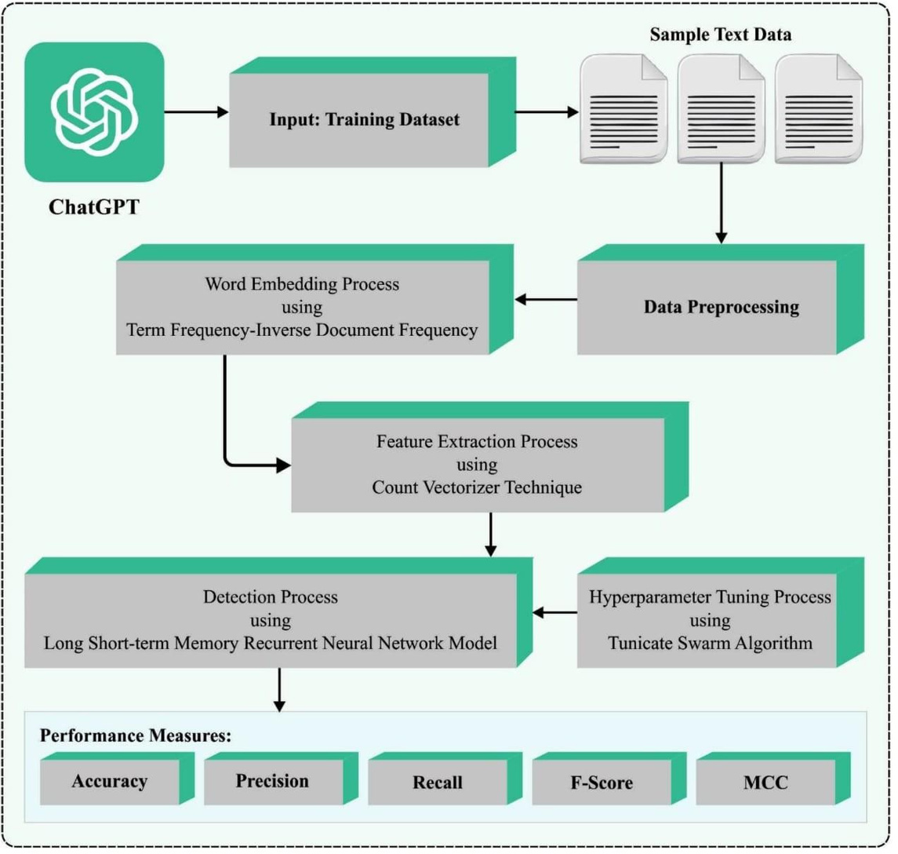
System Architecture

Slide 15

Software requirements
Programming language
--Python
Machine Learning libraries
--Tensorflow
Natural language processing tools
--Spacy
Data visualization
--pandas
--matplotlib
--seaborn
Hardware requirements
Computing Resources
--GPU
--TPU
Storage
Memory

Slide 16
Project plan
Framework development
Reviewing existing text analysis frameworks, extract key features distinguishing AI and human-generated text, and construct a comprehensive framework encompassing syntax, semantics, and pragmatics. Validate the framework's effectiveness through rigorous human evaluation.
Feature analysis
Utilize the developed framework to analyze AI and human-generated content, extracting features like writing style and coherence. Apply the framework, record observations, and conduct statistical analysis to quantify differences between AI and human-generated text .
gap investigation
Investigate the gap between AI-generated and human-written text by researching and selecting methods. Apply chosen methods to diverse text sets, evaluate effectiveness, and document findings, assessing the reliability of the methods for future insights.
Report and presentation

Slide 17

References
AI vs. Human - Differentiation Analysis of
Scientific Content Generation
Yongqiang Maa,＊ , Jiawei Liu a,＊ , Fan Yi a ,
Qikai Cheng a , Yong Huang a , Wei Lu a,＊＊,Xiaozhong Liu b
a Wuhan University, China
b Worcester Polytechnic Institute , USA
Remy
Marsh
Everest Cantu
Drew Holloway
Morgan Maxwell
Manager
Marketing
Business Head
Manager

Slide 18
THANK YOU

